Slide 1
Online Artwork Booking Website
Guide Name:
Mrs.J.Jakkulin Joshi MCA,M.Tech(IT)
Designation : The Assistant Profesor
Department Of IT.
The American College.
Student Name
Presentation By
K.Kaliraj
21BIT120
Department of IT.
The American College.

Slide 2
Contents
1.Introduction
1.1Abstract
2.System Analysis
2.1 Existing System
2.2 Proposed System
3. System Requirements
3.1 Software requirements
3.2 Hardware requirements
4. Module description
5. System Design
5.1 Data flow diagram
5.2 Database design
6.Screen Shots.
7. System Implementation
8. System Testing
9. Conclusion
10. Future Enhancement

Slide 3
Introduction
An online artwork booking website is a platform that allows users to browse, select, and book artwork for various purposes, such as events, exhibitions, or personal collections.Creating an online artwork booking website is a complex process that requires attention to detail and continuous improvement based on user feedback and industry trends. Collaboration with artists, designers, and potential users can greatly enhance the platform's usability and appeal.

Slide 4
Abstract
This Abstract Outlines The Development And Features Of An Innovative Online Artwork Booking Web site, Crafted Using HTML,CSS,PHP and Javascript. This Platform serves as a Digital Hub For Art Enthusiasts, Collectors and Artists to Seamlessly Explore, Book and Engage With a Diverse Spectrum of Artworks. This Website Boasts An Intuitive and Visually Appealing User Interface, Designed with HTML and CSS.

Slide 5
Existing System
1.user registration.
2.Browsing available artwork.
3.Selecting pieces for booking.
4.Payment processing.
5.A confirmation system.

Slide 6
Proposing System
A new dashboard feature.
1.Easily track likes.
2.Comments.
3.Ratings in one central place.
4.User engagement and feedback.
5.Monitoring and managing interactions on the platform.

Slide 7
System Requirements
Software Requirements:
Front-end Development (HTML, CSS, JavaScript):
HTML (Structure):
Create the website's structure with HTML to include various sections, forms, and placeholders for content.
CSS (Styling):
Style the HTML elements for a visually appealing layout.
JavaScript (Interactivity):
Implement client-side interactions, such as form validation, dynamic content loading, etc.
PHP:
Handle server-side scripting for processing form data, managing sessions, interacting with the database, etc.
Back-end Development (PHP and MySQL):
1.MySQL:
Create a database to store artwork details, user information, bookings, etc.
Establish connections, perform CRUD operations (Create, Read, Update, Delete), and manage data within the database.

Slide 8
Hardware Requirements
Device name LAPTOP-E5ME67S3
Processor Intel(R) Core(TM) i3-10110U CPU
Processor speed 2.10GHz 2.59 GHz
Installed RAM 8.00 GB
System type 64-bit

Slide 9
Module Description
Administrator: An Administrator is responsible for managing and overseeing the operations, functions, or systems within an organization.
Register User: A Register User is an individual who has signed in or created an account. Fill the required fields like user name, email, password etc..
Dashboard System: A Dashboard system provides you can easily track likes, comments, views, and ratings/reviews in one central place.
Payment Gateway: A Payment Gateway is a service that facilities online transactions by securely authorizing and processing payments from customers to artists or the platform itself.
Notification System: A Notification system is a feature that sends alert or messages to users regarding various activities,updates or events related to their interactions on the platform.

Slide 10
System Design
Data Flow Diagram
Register User
Online Artwork Booking Website
Administrator
DashBoard
Notification System
Payment process

Slide 11
Data Flow Diagram
Level 0
Login
Manage users
Logout
Administrator
Manage Artworks
Dashboard Profiles
Generate Report

Slide 12
Level 1
logout
Browse artwork
login
Search artwork
Register User
Sign
up
View artwork details
Add artwork to favourite
View booking request
Make booking request

Slide 13
Level 2
View Artwork Ratings
View Likes
View comments
Institiute
Dashboard
settings
views

Slide 14
Level 3
Payment Gateway
Process Payment
Notification System
Send Notification

Slide 15
Database Design
1.Users: User_id, username, email, password, etc.
2. Artworks: Artwork_id, title, artist, description, price, etc.
3.Bookings: Booking_id, user_id (foreign key referencing Users), artwork_id (foreign key referencing Artworks), booking_date, return_date, etc.
4. Transactions (optional, for payment):Transaction_id, booking_id (foreign key referencing Bookings), amount, payment_status, etc..

Slide 16
System Testing
1.Functional Testing: Ensure all features like artwork search, booking, user authentication, payment processing, etc., work as expected.
2.Compatibility Testing: Check website performance across different browsers (Chrome, Firefox, Safari, etc.) and devices (desktop, tablet, mobile).
3.Usability Testing: Evaluate the user interface, ease of navigation, and overall user experience.
4.Security Testing: Assess the website's security measures to prevent data breaches, SQL injections, and other vulnerabilities.
5.Database Testing: Verify data integrity, accuracy, and how the website interacts with the database.

Slide 17
Future Enhancement
1.Social Media Integration: Enable users to share their favorite artworks or bookings on social media platforms, expanding the website's reach.
2.Live Chat Support: Integrate a live chat feature for customer support, providing real-time assistance to users regarding artwork inquiries, bookings, or issues.
3.Artwork Upload for Artists: Provide a platform for artists to upload and showcase their artworks, managing their own profiles and listings.
4.Multi-Language Support: Implement multilingual support to cater to a broader audience and make the website accessible to users from different regions.

Slide 18
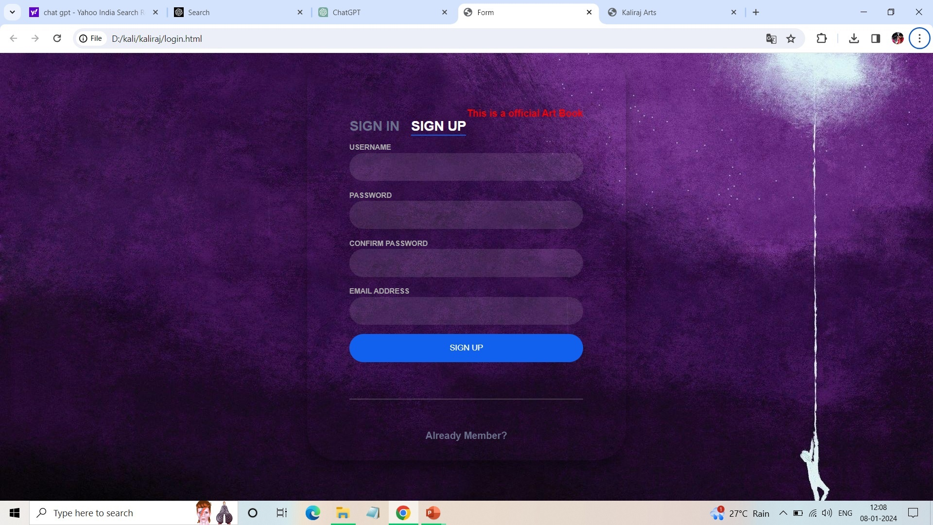
Screen Shots
Registration Form

Slide 19
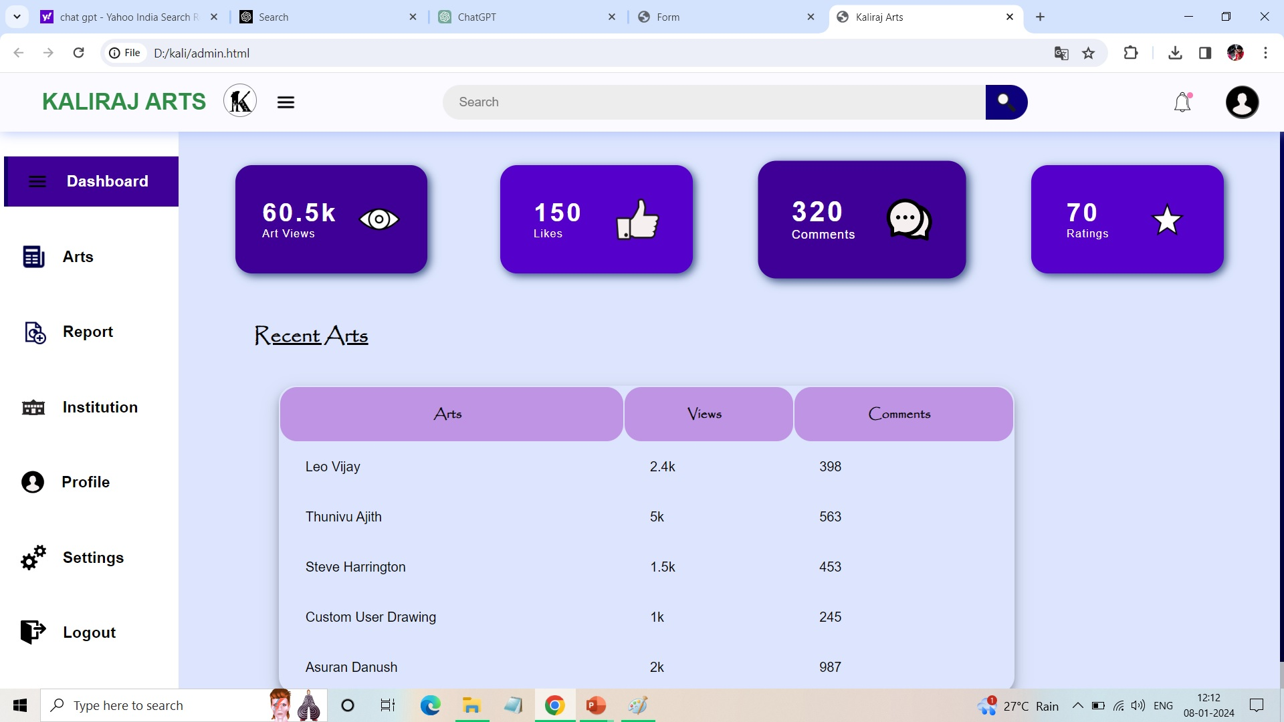
Dashboard system

Slide 20
Conclusion
This technologies empowers the creation of a comprehensive and interactive online artwork booking platform. Through HTML, CSS, JavaScript, PHP, and MySQL, the website can provide a seamless user experience, robust functionalities, data security, and efficient data management.

Slide 21
Thank You

